Slide 1

SOC Analyst Career Path
Your First Step into Cybersecurity

Slide 2

Introduction

Slide 3

01
Role Overview

Slide 4
Definition of SOC Analyst
A SOC Analyst (Security Operations Center Analyst) is a cybersecurity professional responsible for monitoring, detecting, investigating, and responding to security threats in real-time. They are the first line of defense within an organization’s cybersecurity infrastructure.

Slide 5

Importance in Organizational Defense
SOC Analysts play a critical role in an organization's defense strategy against cyber threats. They act as the first line of defense by actively monitoring and analyzing security events, thereby helping organizations swiftly respond to potential breaches, minimize impact, and safeguard sensitive information.

Slide 6
Day-to-Day Responsibilities
The daily responsibilities of a SOC Analyst include reviewing security alerts, performing triage of incidents, collaborating with IT teams, and documenting findings. They engage in continuous monitoring of network traffic and systems, work on incident response efforts, and maintain communication with stakeholders regarding security posture.

Slide 7

02
Key Responsibilities

Slide 8
Real-time Threat Monitoring
SOC Analysts continuously monitor network systems for unusual activity that may indicate a security breach. They utilize Security Information and Event Management (SIEM) tools to gather and analyze logs and alerts, ensuring that any potential threats are identified and addressed promptly.

Slide 9

Incident Response & Remediation
In the event of a security incident, SOC Analysts are responsible for initiating the incident response process. This involves identifying the source of the threat, mitigating the impact, and restoring systems to normal operation. They also collaborate with other IT staff to implement remediation strategies and document response actions.

Slide 10
Reporting and Documentation
SOC Analysts must accurately document security incidents and responses to facilitate auditing and compliance. This includes generating reports that summarize incidents, actions taken, and recommendations for improving security measures. Clear documentation is essential for understanding trends and enhancing organizational defenses.

Slide 11

03
Required Skills

Slide 12

Technical Skills: Networking, Operating Systems, SIEM
A SOC Analyst must have a strong foundation in networking principles, including understanding how different protocols interact within a network. Familiarity with operating systems, especially Windows and Linux, is crucial, as analysts need to evaluate system vulnerabilities and secure configurations. Knowledge of Security Information and Event Management (SIEM) systems is vital for monitoring logs, alerts, and incident management.

Slide 13
Analytical Thinking and Communication
Analytical thinking is essential for SOC Analysts as they need to assess complex security data to identify genuine threats amid noise. Effective communication skills are equally important, as analysts must convey technical information clearly to non-technical stakeholders and collaborate efficiently with incident response teams.

Slide 14
Coding and Scripting Proficiency
Proficiency in coding and scripting allows SOC Analysts to automate repetitive tasks, enhance data analysis, and streamline incident response workflows. Familiarity with languages such as Python, PowerShell, or Bash scripting can significantly improve an analyst's effectiveness in managing security tools and integrating systems.

Slide 15

04
Tools Overview

Slide 16
Introduction to SIEM Tools
Security Information and Event Management (SIEM) tools are crucial for SOC Analysts. They consolidate security data from various sources within an organization, allowing for real-time monitoring and correlations of events. SIEM systems play a pivotal role in detecting threats early, managing incidents, and ensuring compliance with regulatory requirements.

Slide 17

Examples of Common Tools
Popular SIEM tools include Splunk, IBM QRadar, Azure Sentinel, Elastic Security, and LogRhythm. Each of these platforms offers unique features that assist SOC Analysts in addressing security threats through log management, alert correlation, and providing actionable intelligence to improve overall security posture.

Slide 18
Data-Flow Infographic of SIEM
The data-flow infographic for SIEM illustrates how data is ingested from different sources, such as servers, endpoints, and network devices, and processed within the SIEM system. This visualization helps highlight the flow of information leading to event correlation, alert generation, and incident response initiation.

Slide 19
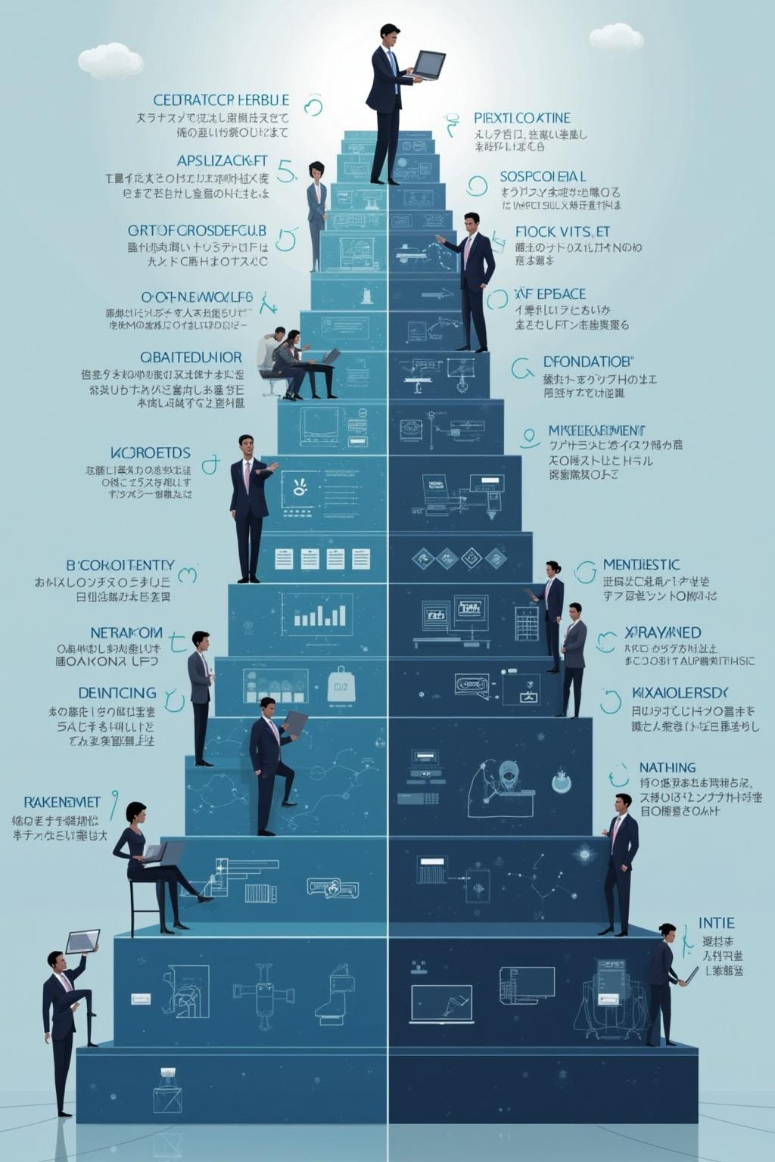
05
Career Path

Slide 20

Tier Progression: Tier 1 to Tier 3
SOC roles typically follow a tiered structure, starting from Tier 1, which focuses on monitoring and triage of alerts, moving to Tier 2, which involves deeper analysis and incident handling, and advanced roles in Tier 3 that require specialized skills such as threat hunting and forensics.

Slide 21
Potential Growth Areas
Beyond traditional SOC Analyst roles, professionals can advance into positions such as Threat Hunter, Incident Responder, or Cybersecurity Consultant. Continuous learning and adaptation to evolving threats create opportunities for specialization in emerging areas like threat intelligence, cloud security, and compliance.

Slide 22
Recommended Certifications
To enhance career prospects, SOC Analysts should consider pursuing relevant certifications such as CompTIA Security+, EC-Council Certified Security Analyst (CSA), Splunk Core Certified Power User, and GIAC Certified Intrusion Analyst (GCIA). These certifications validate expertise and can significantly improve employability in the field.

Slide 23

Conclusions
In summary, a successful career as a SOC Analyst demands a combination of technical skills, analytical thinking, and effective communication. By leveraging the right tools and continuously pursuing professional development, individuals can advance through the cybersecurity landscape, ultimately contributing to the protection of organizational assets against ever-evolving threats.

Slide 24

Thank you!
Do you have any questions?
+00 000 000 000

